Slide 1
Curriculum Evening
Year 4
September 2022
Presented by Mrs Butler, Mrs Taziker and Miss Job

Slide 2


Welcome to the
Year 4 team
Class 8
Miss Job
Class 7
Mrs Butler (Monday, Tuesday and Wednesday)
Mrs Taziker (Wednesday, Thursday and Friday)
Amazing Teaching Assistants
Mr Biggins, Mrs Coughlin, Mrs King, Mrs Malcolm
and Mrs Booth

Slide 3
Our School Mission Statement:
Love your neighbour as yourself.
Luke 10. Vs 28
Core Values
Faith, Love and Hope.
1 Corinthians 13:13

Slide 4
School Rules:
Be Safe
Be Ready
Be Respectful

Slide 5
Our School Vision Statement:
Inspiring, nurturing and educating our children to serve God, by reaching their full potential, serving our local community and by looking after our environment as global citizens of today and tomorrow.

Slide 6

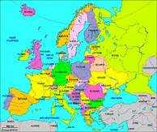
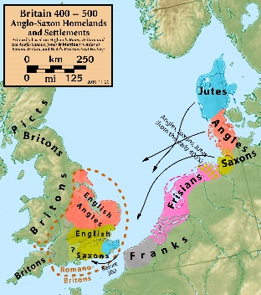
Year 4 Curriculum.
Autumn Term – Our World
Ancient Egyptian
Europe
Christmas Service
Spring Term – Our Community
STEAM
Gender Equality
Swimming
Summer Term – Our Environment
Vikings
Local area

Slide 7




Homework
Online tasks will be set every FRIDAY to be completed by the following THURSDAY.
Mathletics
Spelling Frame
TT Rockstars
Spag.com

Slide 8
Homework
Reading books
We encourage children to read a variety of literature, both their school book and others of their own choosing. Any reading can be recorded in their Reading Logs.
Monday – Ashton
Tuesday – Beacon
Wednesday – Hilbre
Thursday – Marine
Friday - Shore

Slide 9
How can you help at home?
Read for 10 mins everyday, this does not always have to be their school reading books. Ask questions to check understanding.
Practise counting in steps of 6, 7 and 9 from 0 and in 10’s from any two and three digit numbers.
Begin to add two 4 digit numbers mentally and move onto adding two 4 digit numbers.
Begin to learn 6x, 7x, 9x, 11x and 12x tables and when ready division facts for these tables.
In June there will be a Statutory Times Tables Test that all children have to complete online.
Practise telling the time.

Slide 10

E-safety
Keep your personal stuff private and
think about what you say and do online.
Remember that people online may not be who they say they are. Online friends are still strangers even if you have
been talking to them for a long time.

