Slide 1
September 2022
Mathematics Curriculum
Information

Slide 2
Mathematics
2 areas:
Number
Numerical Patterns

Slide 3
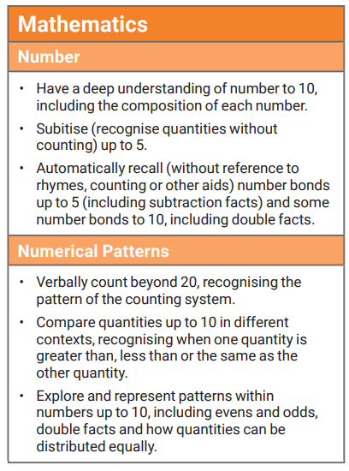
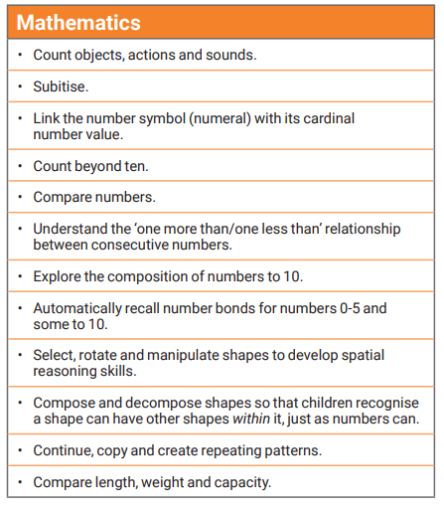
The Early Years Foundation Stage curriculum
Early Learning Goal
Development Matters Statements

Slide 4
How we teach mathematics.
Number of the week. We take a number and explore it in more depth for the whole week (sometimes two weeks if we feel it is needed)
We take a number/concept and really embed it.
We focus on:
Counting and fluency- Counting: saying number names in sequence. Tagging an object with a number name. Cardinality- the last number you say when counting is the amount in the set; one to one correspondence- when counting your finger matches to the voice to ensure accurate counting, look for rows and moving when counting. Conservation of number- Knowing that the number does not change if things are rearranged (so long as none have been added or taken away) Subitising: recognising small quantities without needing to count them all.
Pattern- Recognising shapes and matching. The shape pattern of a number for representation. Creating and continuing a repeating patterns. Spotting patterns in our environment. Exploring patterns in songs, stories and rhymes.
Comparison- Identifying groups with the same number of things. What number comes after/before? more/less/fewer.

Slide 5
Cont…
Composition- Understanding that one number can be made up from (composed from) two or more smaller numbers. Number operations- addition, subtracting, counting in multiples. Sets and number composition-recalling number bonds to solve problems.
Time- o’clock, half past the hour. Setting and reading times.
Weight- using scales, bucket balances- discussing differences
Capacity- floating and sinking. Investigations,- full, empty, half full, more and less etc
Length/height- using the correct mathematical language. Using standard and non standard forms of measurement within the provision.
Money- identifying coins and notes. Paying for items, giving change.
Shape; 2d and 3d shapes. Discussing properties of shapes. Shape patterns.
For example, the number 1. We look at the numeral, place value, representations, what it looks like in the environment, money, time, pattern etc.
So when you child tells you they are learning about the number of the week, this is what is going on behind the scenes!

Slide 6
Mathematical language.
Language: We introduce mathematical language from the very beginning. We use the correct terms when learning the different concepts.
Language is reinforced for each number of the week, so children quickly become familiar and fluent with this language and the meaning of it.
In our weekly updates on Tapestry, we will let you know the type of language we have been using.

Slide 7
Showing our thinking-Journaling
Our curriculum now focuses on grasping a deeper understanding (mastery) of the value of numbers to 10. However, our number of the week approach will focus on numbers up to 20 and beyond.
This way children will become masters of those numbers up to 20 and will be able to problem solve and discuss in depth.
Once children are competent with accurately counting and applying their skills we can move on to journaling and recording their thinking. Firstly we will look at recording/representing their number of the week. When composition of number develops we will start to introduce problem solving.
We use the following approaches-
Concrete- using physical objects to solve maths problems- this could be counters, real life objects, cubes etc. Practically able to explore a problem. Pictorial- using their mathematical drawings to solve their maths problems- Giving meaning to their understanding. Non standard forms of recording. Abstract- solving maths problems and recording using number sentences.

Slide 8
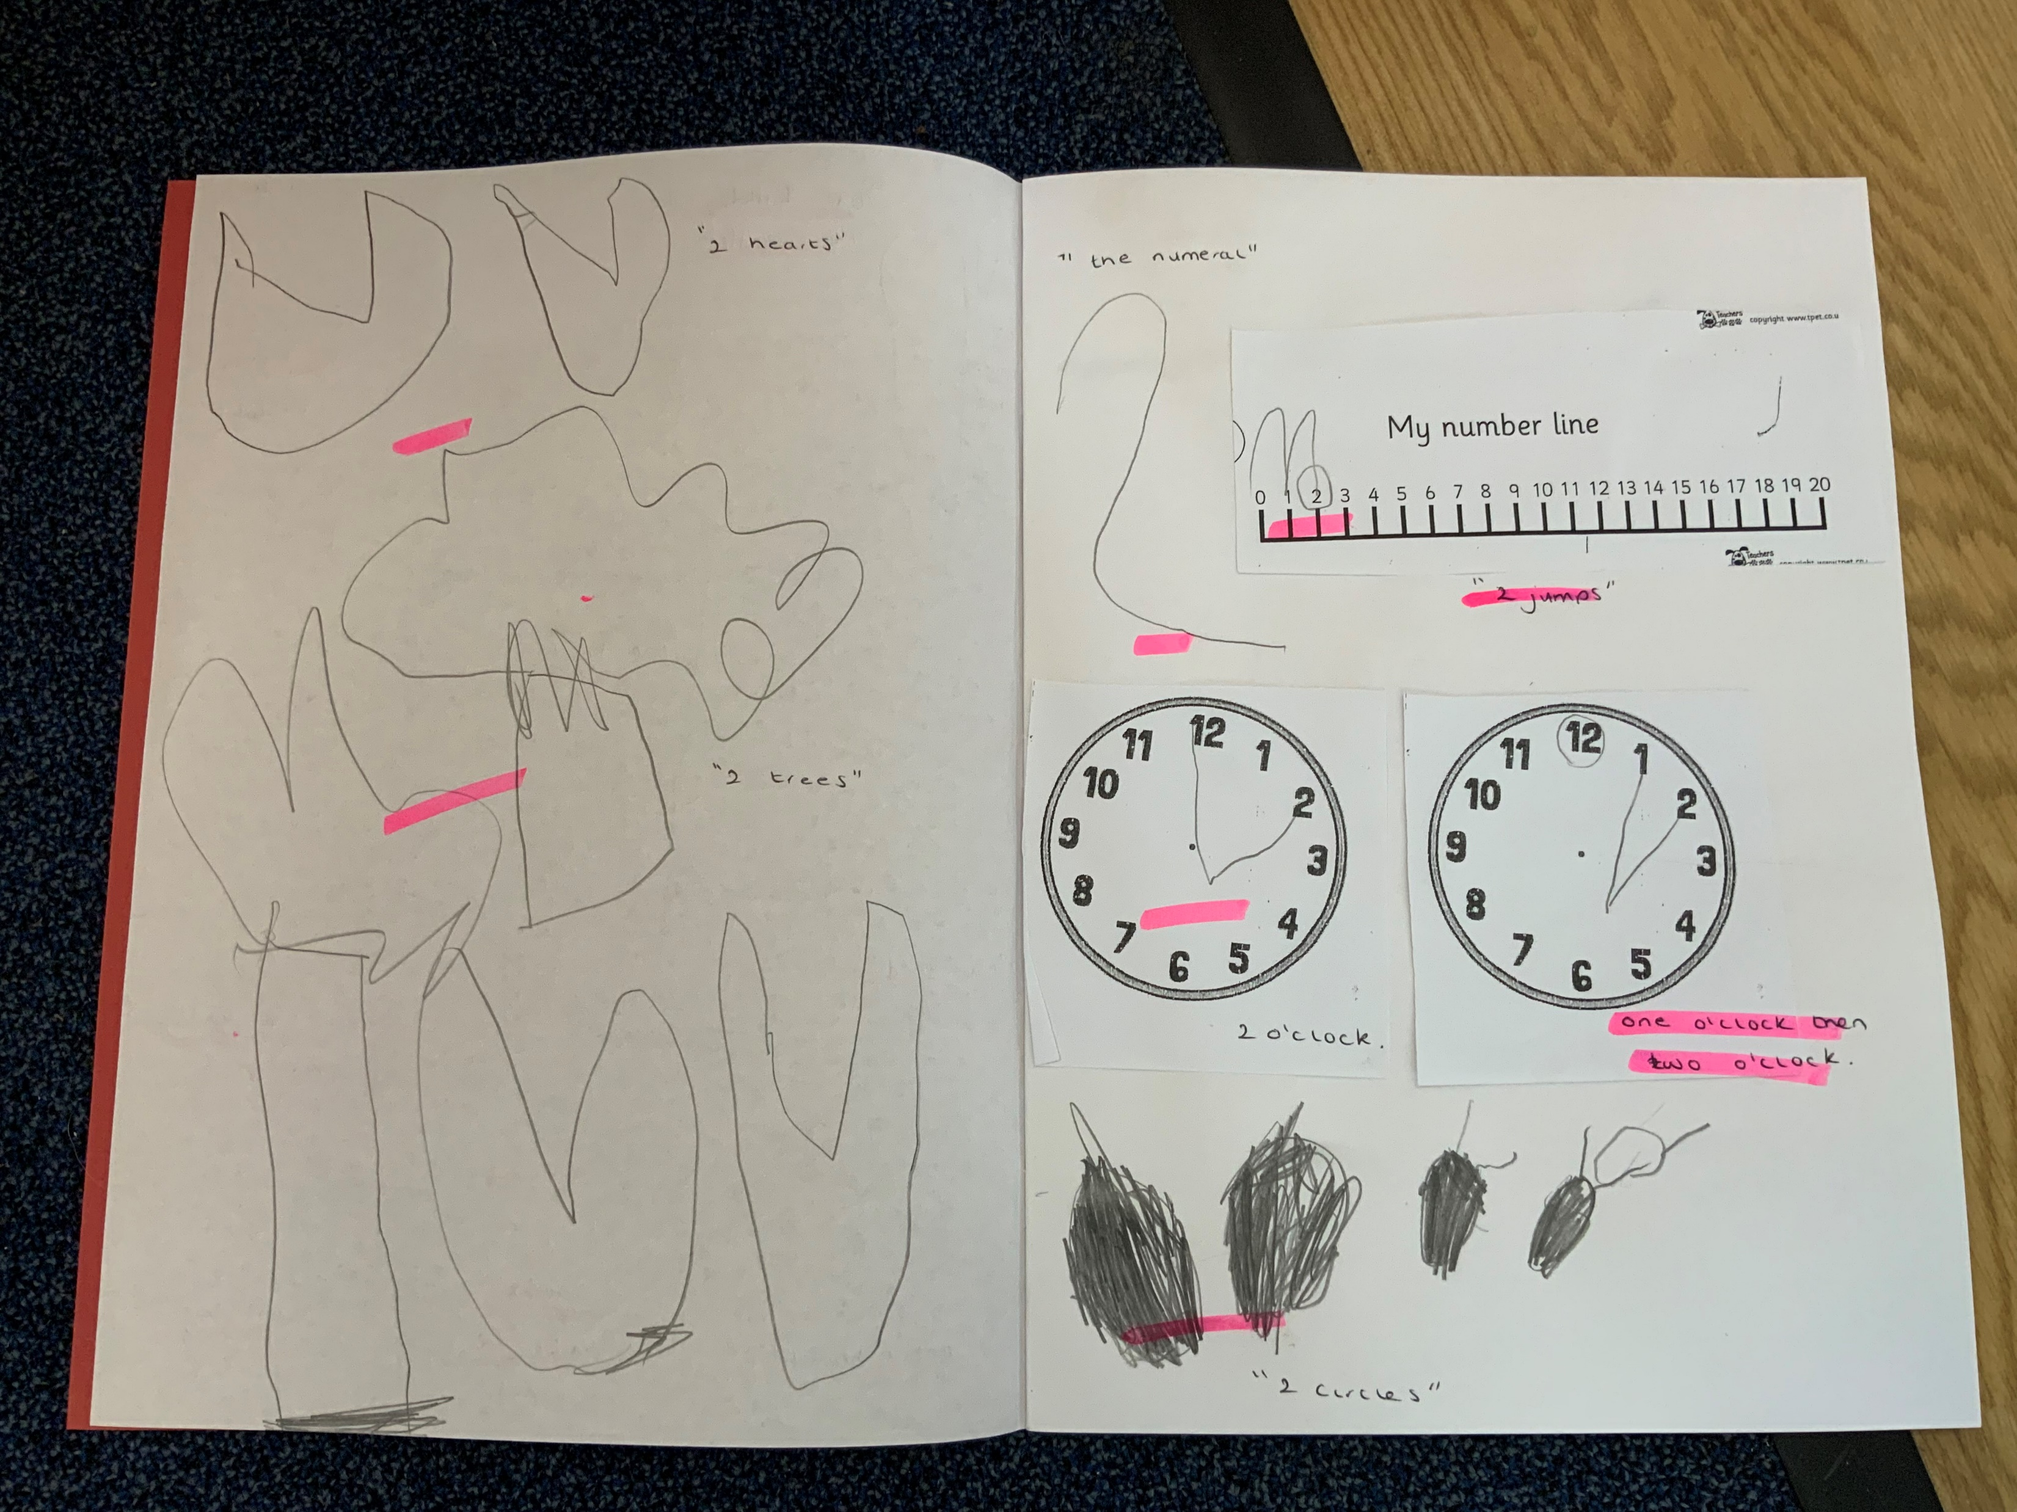
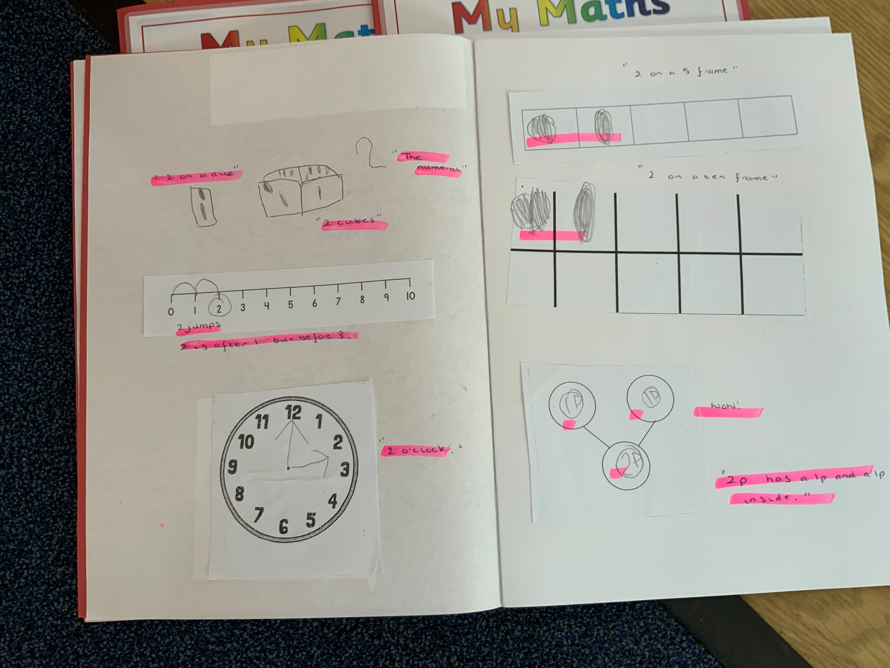
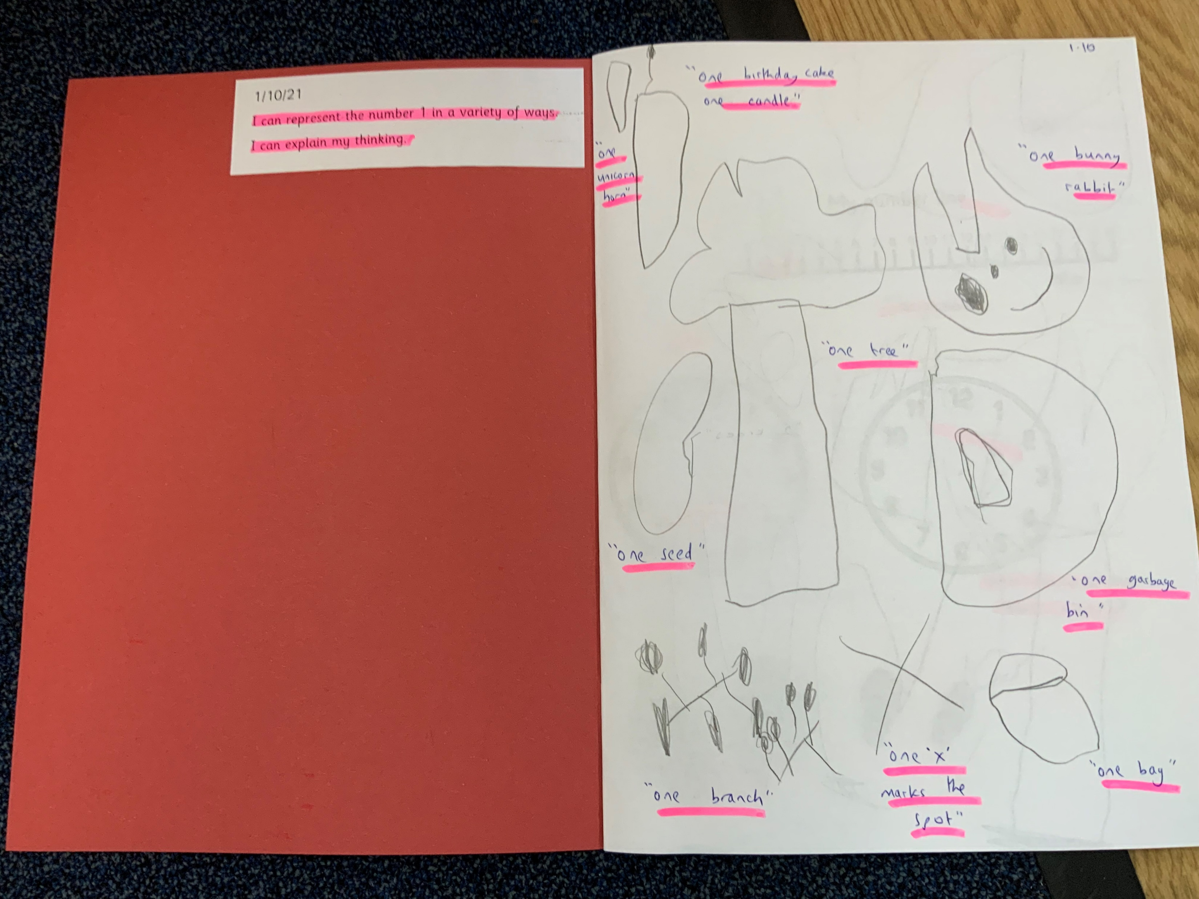
Problem solving-
An example of children’s journaling that may take place in the coming weeks.

Slide 9
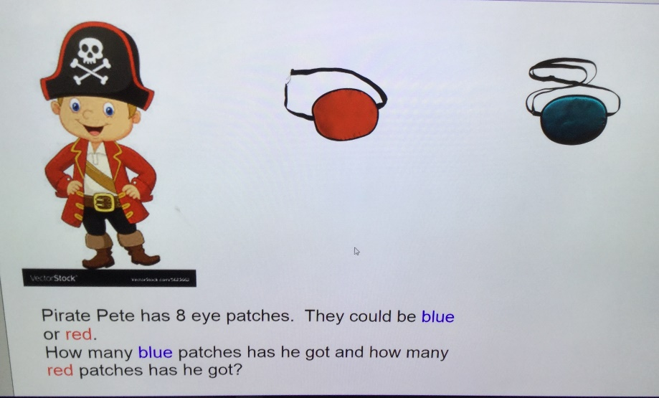
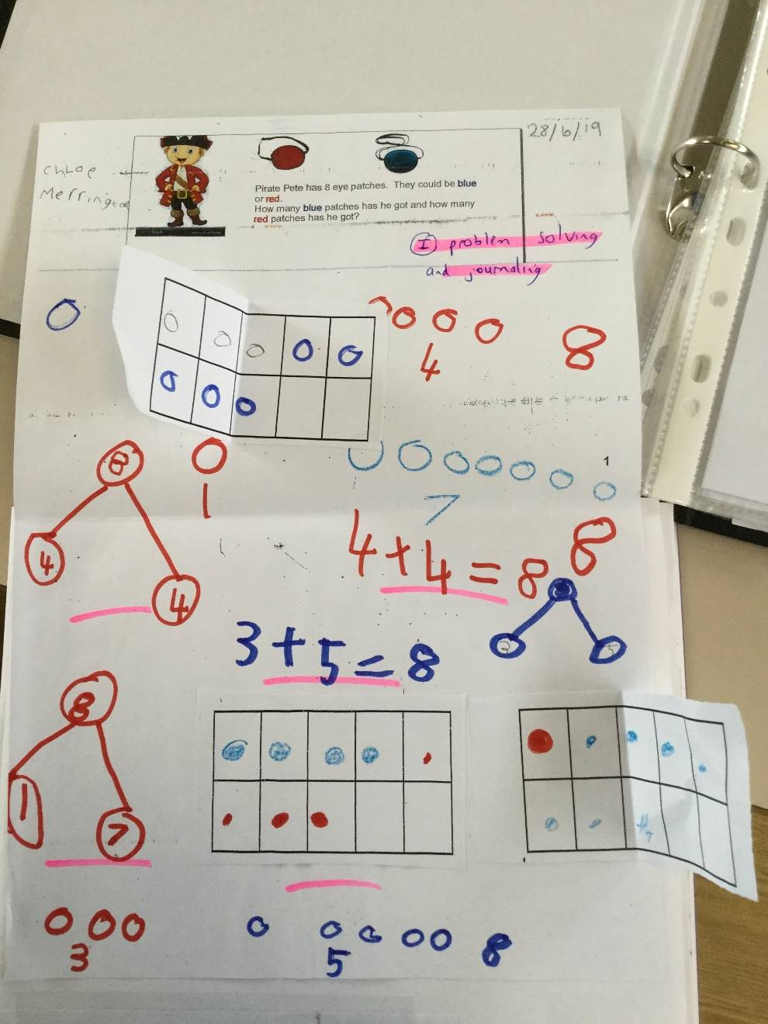
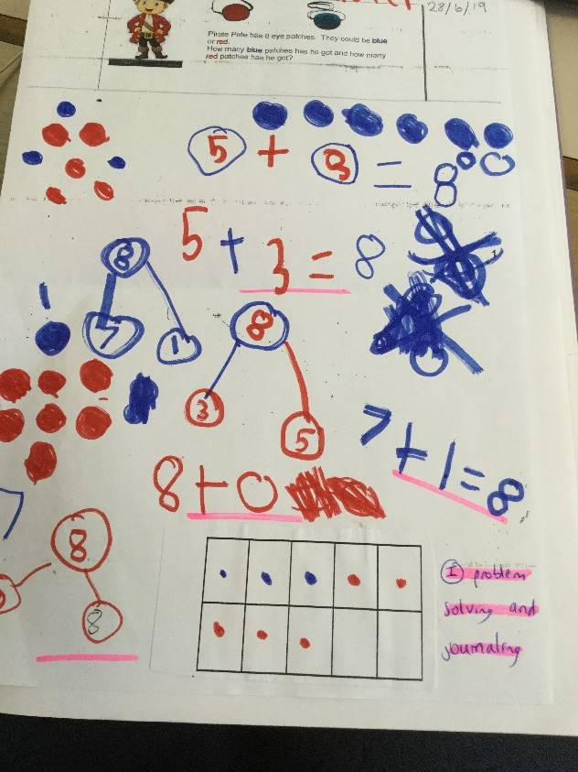
Problem solving This is an example of Summer term journaling.

Slide 10
How you can help at home
Number formation
Model number writing and reading in different ways: Lists, birthday cards, buses, front doors, recipes, in books, phones
Number hunts
Write in sand, with your finger on the carpet, paint, make numbers with play dough, on a whiteboard, on paper, post it notes, on a tablet

Slide 11
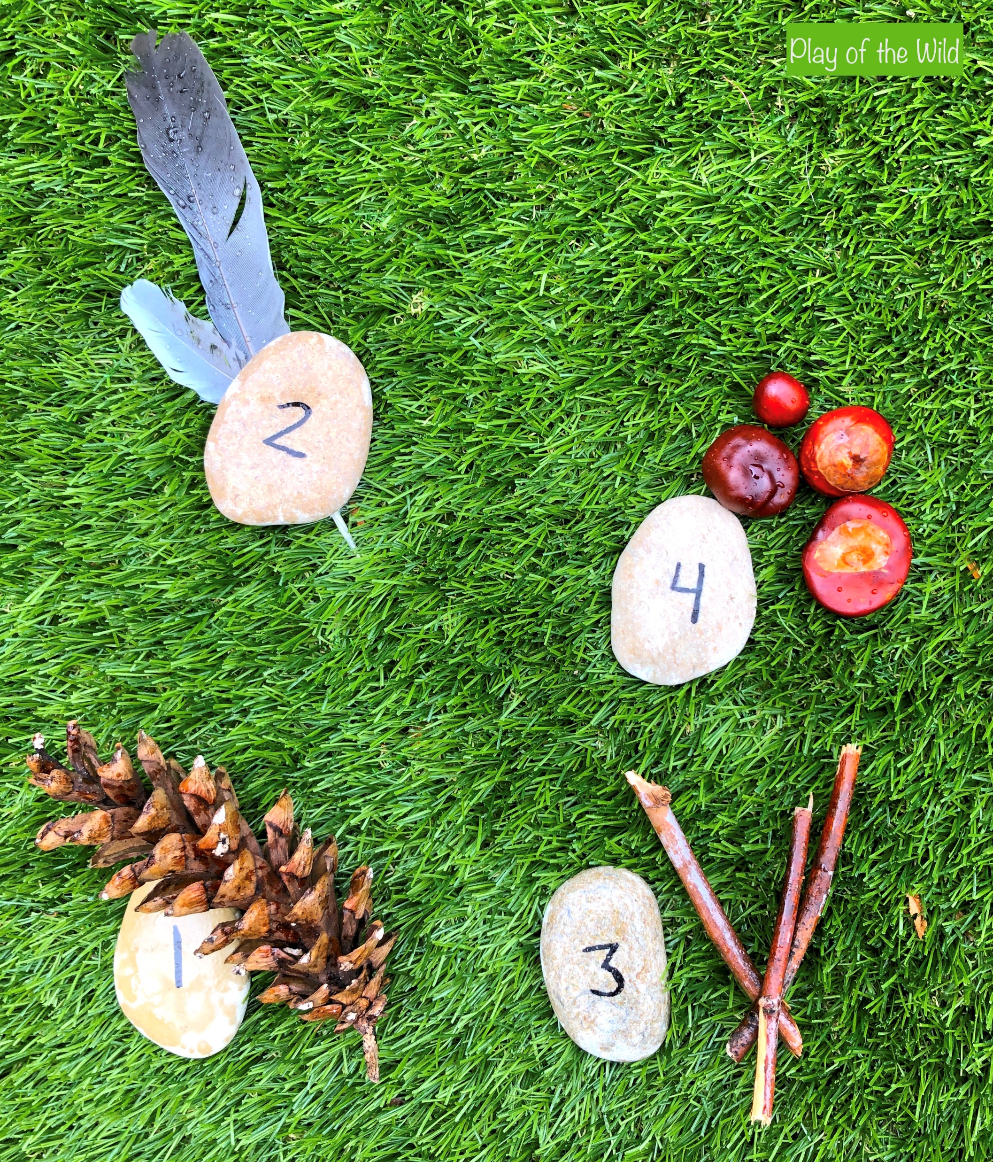
How you can help at home?
Counting
Counting – in everyday conversation, in play, steps, brushing teeth,
toys in the bath, tidying toys
Subitising – with teddies, spoons, socks
Ordering numbers – flashcards, post it notes, lining up toys
Number bonds – in the car, with teddies/toys
Addition and subtraction – include it in everyday conversation, cooking

Slide 12
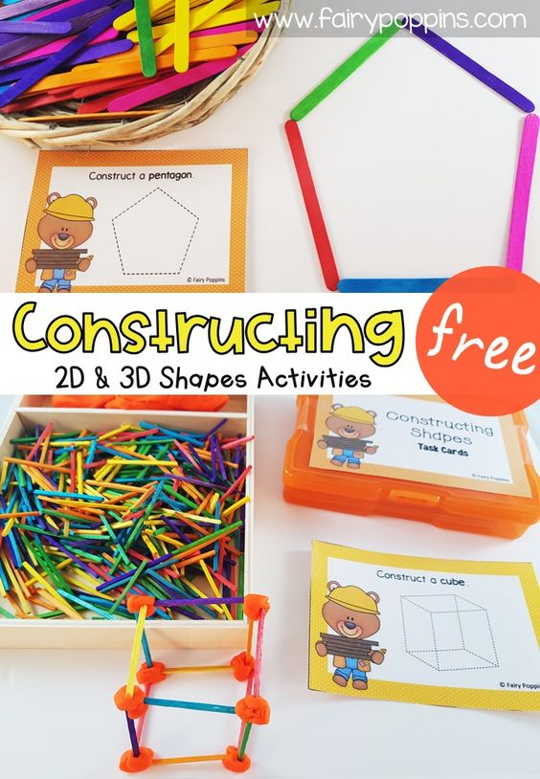
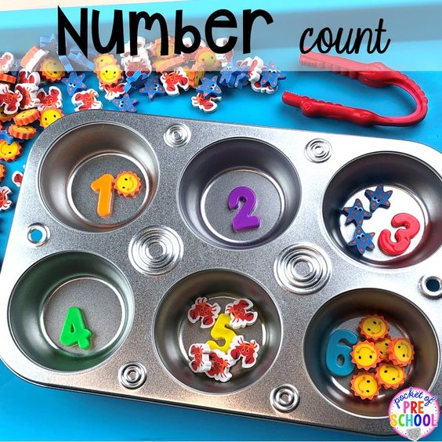
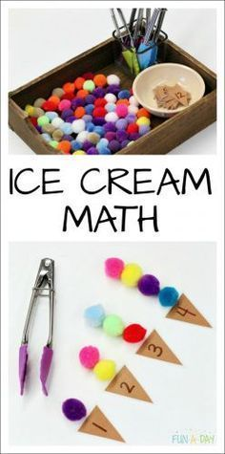
How you can help at home?
Games
Snakes and ladders
Board games
Card games – snap, pairs
Number hunts
Hide and seek
Bingo
Link it to fine motor activities
Counting songs

Slide 13
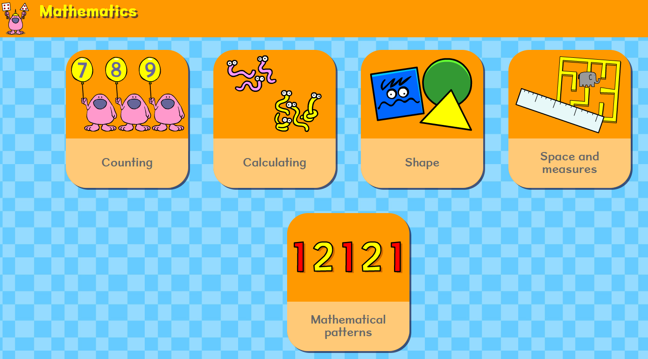
Useful websites
https://www.topmarks.co.uk/maths-games/hit-the-button - Quick fire maths
http://www.mathsphere.co.uk/resources/MathSphereSampleWorksheets.htm - Printable maths worksheets, free resources, fun and games.
https://www.mathsisfun.com/ - A range of maths games.
https://www.busythings.co.uk/ - Very popular with all of our children!
https://www.bbc.co.uk/cbeebies/games - The games cover the whole curriculum and are tablet friendly.
http://www.crickweb.co.uk/ - Activities focusing on Maths and Literacy. Free to use
https://www.pinterest.co.uk/ - While Pinterest isn’t a learning website as such, it is nonetheless an absolute treasure trove of resources if you would like an activity for your child that isn’t screen based. Pinterest has so many investigative activities that you can make at home, some beautiful art activities and fine motor activities. Type ‘eyfs’ or ‘for kids’ after your search. For example ‘numbers to 10 for kids’ or ‘shape patterns for kids’
https://www.youtubekids.com/ You can search for a wide range of videos on number bonds, shapes, counting, phonics, Alphablocks, Number Jacks etc. ‘Art for Kids’ and ‘Cosmic Yoga Kids’.
https://www.bbc.co.uk/bitesize/articles/zks4kmn?fbclid=IwAR357cwmtmUmaOnHhRVPR5Az4k5OvKP6lrsYs9ZoYAadD5nfcOLzz0GHbCI BBC bitesize has lots of links to activities, games and videos all about maths and other areas of the curriculum

