Slide 1

Curriculum Evening
Mission statement; “Love your Neighbour as Yourself”
School core values Love, Faith, Hope.

Slide 2
RE
Chester Diocese and Wirral schemes
Respect and tolerance for all faiths
Celebration of all festivals (Year 1 Christmas service; 15th December 2.00pm in church)
Collective worship

Slide 3
Expectations: Be safe, be ready, be respectful
Weekly overviews of learning will be updated every Friday via Tapestry.
Homework; set on a Friday via Tapestry. Reading books sent home on a Friday to be returned on a Thursday. Mathletics will be set weekly and linked to prior learning.
PE kit; to be worn every Tuesday and Thursday.
Communication; absences via school office not comms. Changes in daily pick up/messages can be sent via comms. However, messages sent after 12.00pm maybe missed.

Slide 4










Behaviour system

Slide 5

Phonics
Daily sessions using Read Write Inc, your child will then receive books/words to practise at home that contain the sounds learnt that week. There will also be a focus on the reading of real and non real words.
Activities include;
- partner work
speed sounds, word and sentence generation
Child friendly – the children love Fred the frog!
https://www.youtube.com/watch?v=TkXcabDUg7Q

Slide 6

Reading with your child – how you can help.
Read with your child each night and use phonic ‘blending’ strategies to decode unfamiliar words. Eg m/i/l/k or sh/ee/p. We call this Fred Talk.
Discuss the text with your child.
We will be reading with your child every day during our phonic sessions.

Slide 7

Reading with your child - comprehension
We have a specific comprehension session each week to teach the children these skills.
Examples of questions you could ask:
What do you think would happen if?
Why do you think they said that?
How were they feeling?
Was the dog feeling happy? Why?

Slide 8

Maths
Mastery approach in line with the National Curriculum expectations.
Use of resources/manipulatives
Journaling
Workbook

Slide 9
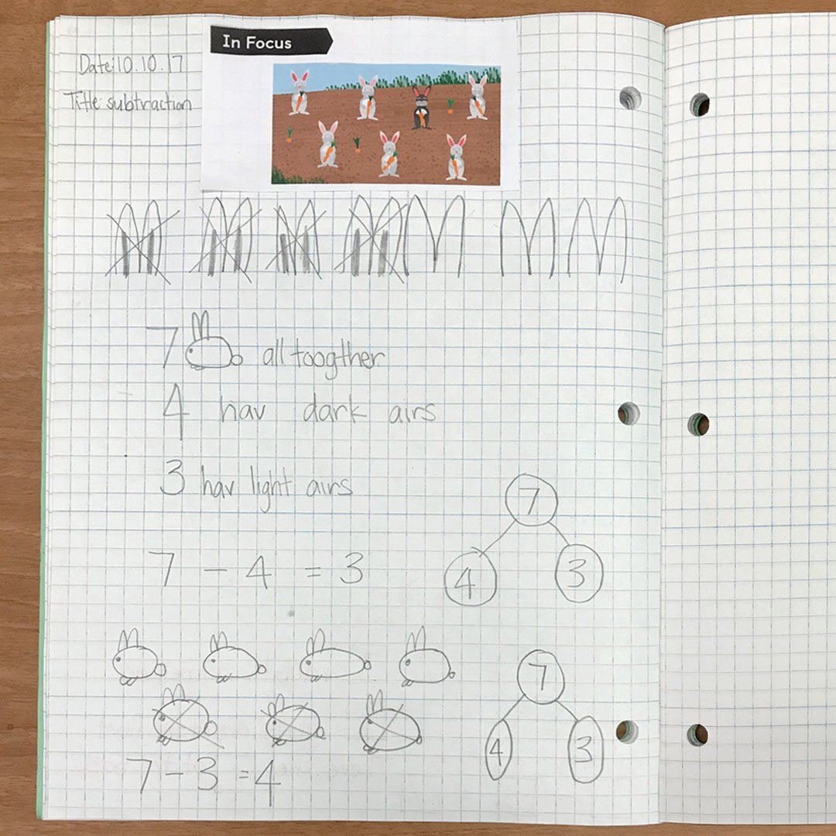
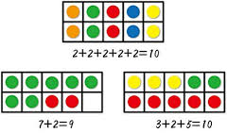

Slide 10
Curriculum Overview Autumn; Our World-
Please see our website for termly updates.
Our sessions are linked to a high quality text to engage the children.
The Gruffalo, Trouble with Trolls, One Day on Our Blue Planet in the Antarctica, One Day on Our Blue Planet in the Savannah.
English and topic may be linked.
Science-
Animals and humans- Senses.
Materials
Wider curriculum
Computing
Music
PE
DT
ART
History and Geography-explorer, Battle of Hasting, Norman Invasion.

Slide 11
Curriculum overview Spring; Our Community
English: Beegu, Great Woman Who Change the World, Little People-Big Dreams.
Science:
Materials
Seasons
Plants
Wider curriculum
PE-dance and ball skills
DT- levers
Art
Music
Social Justice
History and Geography; famous scientists, Oceans of the world, Physical and human features, compass directions, Queen Elizabeth 1 and Queen Elizabeth 11.

Slide 12
Curriculum Overview Summer; Our environment-
Please see our website for termly updates.
English; Our local area; Owl babies. Someone Swallowed Stanley, Flotsam.
English and topic may be linked.
Science-
Animals and humans. Environments. Country code.
Wider curriculum
Computing
Music
PE- Health and Fitness and Athletics
DT- Food
ART
History and Geography- Ashton Park, St Bridget’s school, St Bridget’s church, West Kirby

Slide 13
House keeping: reminders
Be safe, be ready, be respectful underlines all we do.
Water bottles to be named and filled each day.
Uniform to be named.
PE days- no earrings, long hair to be tied back.

Slide 14

E-Safety
E-Safety is monitored by the authority to ensure children and adults can’t access certain sites.
When working on the iPad children know to only access the apps on the iPad.
Are you aware of what your child is accessing at home?

Slide 15

Heartsmart 5 principles
See our school website for more information

Slide 16
year1comms@stbridgets.wirral.sch.uk

