Slide 1
September 2022
Literacy Curriculum including Phonics.

Slide 2
EYFS Statutory Framework.
Educational Programme.
Literacy:
It is crucial for children to develop a life-long love of reading. Reading consists of two dimensions: language comprehension and word reading. Language comprehension (necessary for both reading and writing) starts from birth. It only develops when adults talk with children about the world around them and the books (stories and non-fiction) they read with them, and enjoy rhymes, poems and songs together. Skilled word reading, taught later, involves both the speedy working out of the pronunciation of unfamiliar printed words (decoding) and the speedy recognition of familiar printed words. Writing involves transcription (spelling and handwriting) and composition (articulating ideas and structuring them in speech, before writing).

Slide 3
Early Learning Goals.
The level of development children should be expected to have attained by the end of the EYFS is defined by the early learning goals (ELGs) as set out below.
Literacy
ELG: Comprehension: Children at the expected level of development will: - Demonstrate understanding of what has been read to them by retelling stories and narratives using their own words and recently introduced vocabulary; - Anticipate – where appropriate – key events in stories; - Use and understand recently introduced vocabulary during discussions about stories, non-fiction, rhymes and poems and during role-play.
ELG: Word Reading:
Children at the expected level of development will: - Say a sound for each letter in the alphabet and at least 10 digraphs; - Read words consistent with their phonic knowledge by sound-blending; - Read aloud simple sentences and books that are consistent with their phonic knowledge, including some common exception words.
ELG: Writing:
Children at the expected level of development will: - Write recognisable letters, most of which are correctly formed; - Spell words by identifying sounds in them and representing the sounds with a letter or letters; - Write simple phrases and sentences that can be read by others.

Slide 4
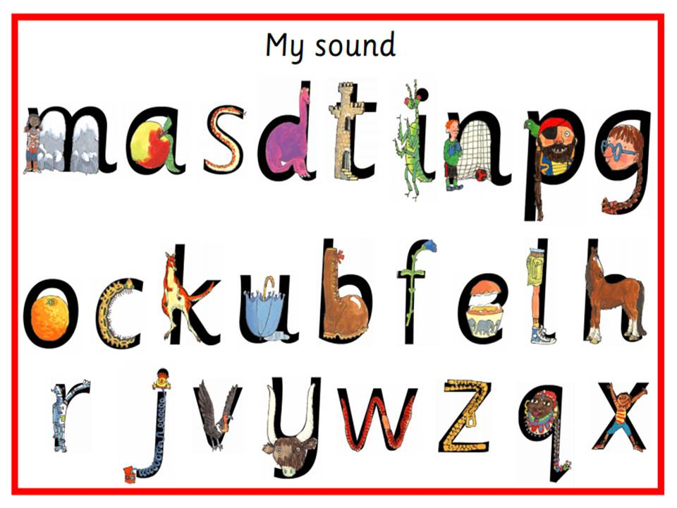
Phonics
We introduce a new letter by saying its name and sound. Letters sounds (a phoneme) have to be learnt as pure sounds- please watch the clip below on how to say the pure sounds.
https://www.youtube.com/watch?v=yln6PpV1G1I
We will update tapestry each week with which letters have been covered in school.
Phonics helps the children to be able to work out unfamiliar words (decode)
Blending and segmenting are vital to help children read and write, but we recognise that there other important factors too and our English language is very complex for our little children to get to grips with.
Red words will be sent home via tapestry to learn as non-decodable words. These are words that we cannot Fred in our head (sound out and blend)

Slide 5
Reading
Fluency is much more important than racing through the levels. It is beneficial for your child to read a book more than once to increase fluency, accuracy and get in to a flow of reading.
New vocabulary is so important and time needs to be spent looking at the meaning of words. – see photograph on next slide.
You need to model and encourage expression. Repetition and rehearsal is important so revisiting of books is a good thing to increase confidence.
Question your child – “What do you think will happen next?”, “Why do think the character did that?”, “What would have happened if..”
Re-tell the story in the correct sequence. Retelling stories is a big focus this year so spend time encouraging your child to re tell familiar stories in their own words.
Can you tell your own version of familiar stories to your child and then get them to make up their own.
Look at non-fiction books. Children will begin to understand what a contents page and index page and what is the difference between fiction and non fiction texts.

Slide 6
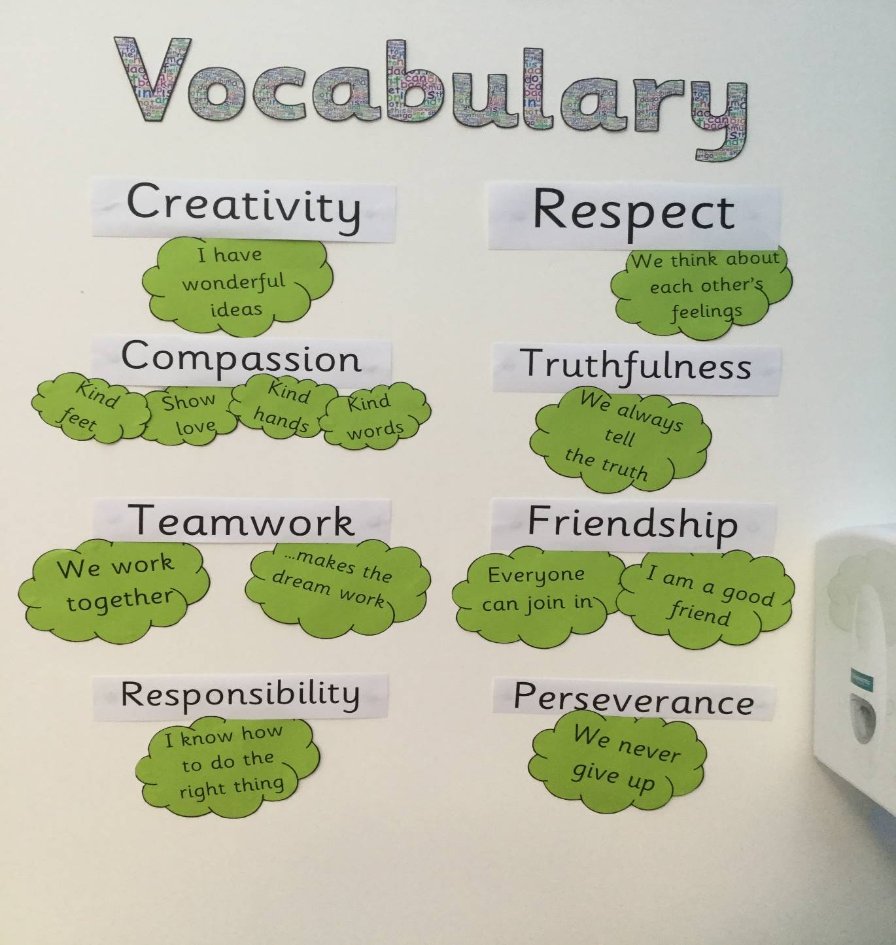

Slide 7
Writing
Letter formation cards – correct formation is vital, ensure your child does not get in bad habits and remind them of the rhymes to help them form letters correctly.
(It is normal for children to reverse letters at this stage).
Not all children are ready to hold a pencil and it does not come natural to them, practise little and often but also practise letter formation with paintbrushes with water / paint or sand, big chalks on the floor or with their finger in the air, flour or sand.
Use magnetic letters spell words, can the children segment sounds in words for spelling purposes.
(It is normal for children to mix the order of letters in words at this stage).
Once the children are ready we will start building simple captions / sentences using finger spaces. Children may struggle to hold the caption / sentence in their head and focus on one word a time but with practise this will come.
We give the children lots of reasons to write – simple sentences, labels, letters, instructions, cards, recipes, stories and much much more.
We will update you on which writing opportunities we have been covering each week via tapestry.

Slide 8
Handwriting style
c,o,a,d,g,q,s,e,u,y,f
i,l,h,r,n,m,b,p,k,j
v,w,z,x
We will continue to focus on correct formation all year so it would be really helpful if you could do the same at home. We are laying the foundations for cursive writing in the future. This will come easily to the children when they reach year 1 and 2 if they are forming all letters correctly by the end of foundation 2. Do not allow children to slip into bad habits.

Slide 9
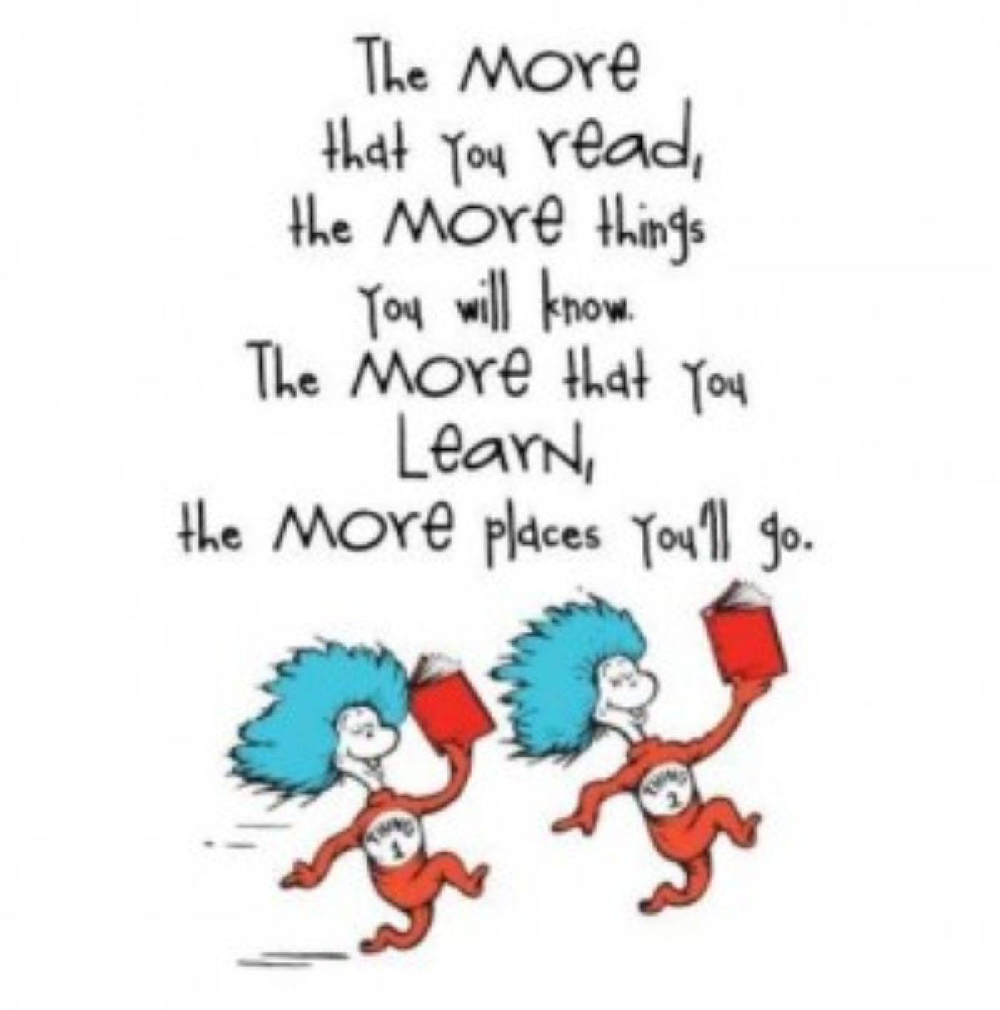
We hope to model a phonics session during our discover and do session after half term.
Date to follow.

